Slide 1








2012 Global Price Forecast
Ohio Valley BTA
Louisville | 18 November 2011
CWT Solutions Group
- Copyright © 2011 CWT

Slide 2




Introductions
Nick Vournakis
VP, CWT Solutions Group, Worldwide
Joel Wartgow
Sr. Director, CWT Solutions Group, North America

Slide 3

Introductions
Nick Vournakis
VP, CWT Solutions Group, Worldwide
Joel Wartgow
Sr. Director, CWT Solutions Group, North America

Slide 4

Agenda
Understanding our approach
What to expect for 2012
  Global overview
  NORAM – Air
  NORAM – Hotel
  NORAM – Rental Car
Q & A

Slide 5
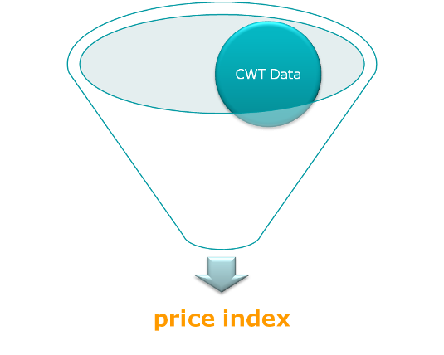
2012 Travel Price Forecast
Understanding our approach
Booked rates from Q1 2006 to Q2 2011
37 countries
Similar approach to the CPI *
Measuring changes in underlying prices * *
* Consumer Price Index
** as opposed to measuring changes in purchasing patterns

Slide 6
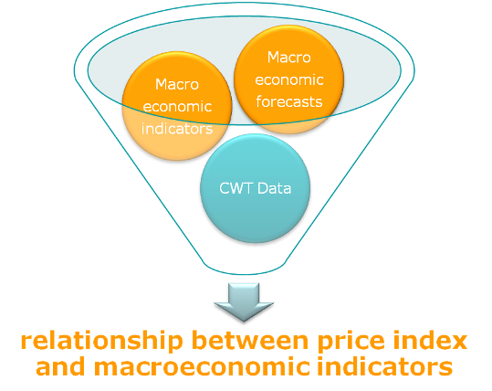
2012 Travel Price Forecast
Understanding our approach
GDP *
Unemployment *
General inflation *
Crude oil *
* Macroeconomic indicators and forecasts come from IHS Global Insight and are supplemented with forecasts from the IMF research departments

Slide 7
2012 Travel Price Forecast
Multi-regression analysis

Slide 8
2012 Travel Price Forecast
Multi-regression analysis
seasonal trend component
t = quarter r = region c = category

Slide 9
2012 Travel Price Forecast
Multi-regression analysis
economic activity component
t = quarter r = region c = category

Slide 10
2012 Travel Price Forecast
Multi-regression analysis
lagged price index
t = quarter r = region c = category

Slide 11
2012 Travel Price Forecast
Multi-regression analysis
???
???
t = quarter r = region c = category
Notes:
Statistical constant and statistical error

Slide 12
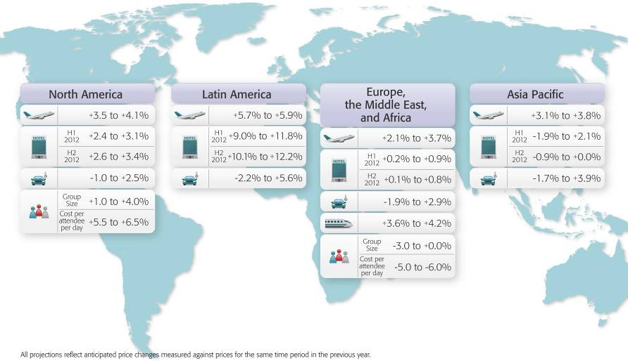
2012 Travel Price Forecast
What to expect?

Slide 13
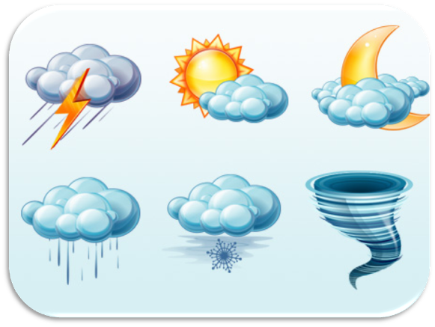
2011 Forecast Recap
How did we do?

Slide 14
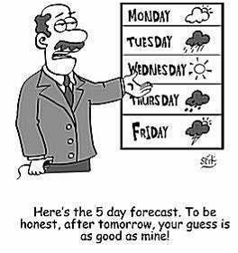
2011 Forecast Recap
How did we do?

Slide 15
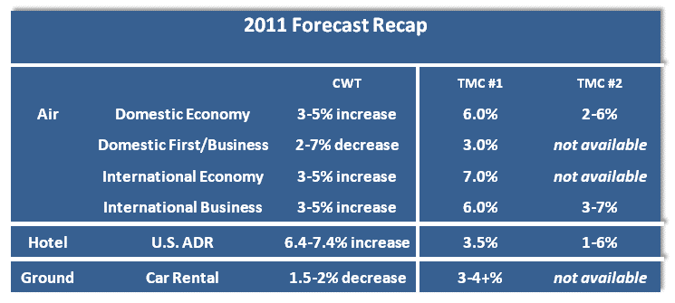
2011 Forecast Recap
What did we say?

Slide 16
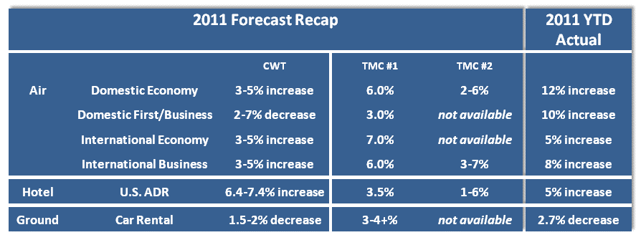
2011 Forecast Recap
How did we do?

Slide 17
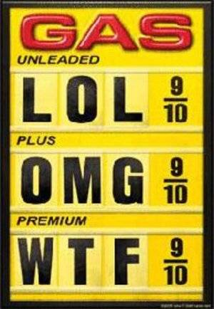
2011 Forecast Recap
Domestic Air - What happened?

Slide 18
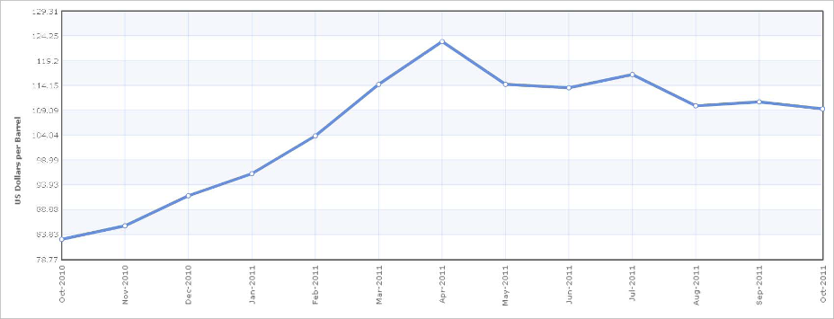

2011 Forecast Recap
Air - What changed?
Higher than anticipated fuel prices!
Strong demand and continued capacity discipline
(even for premium domestic travel)

Slide 19
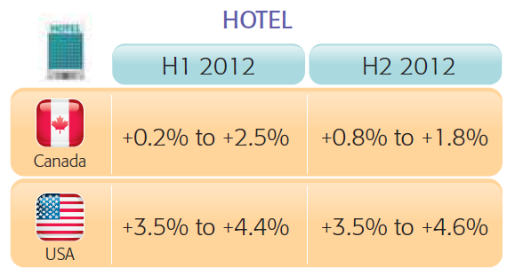
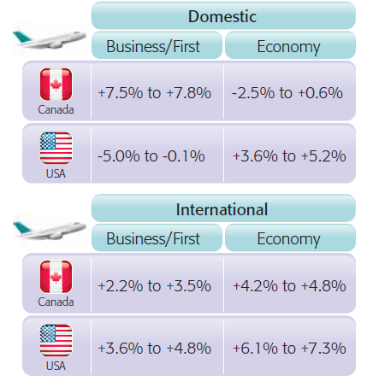
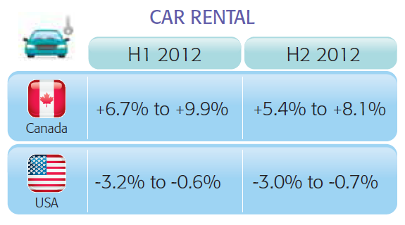
2012 Forecast
NORAM

Slide 20
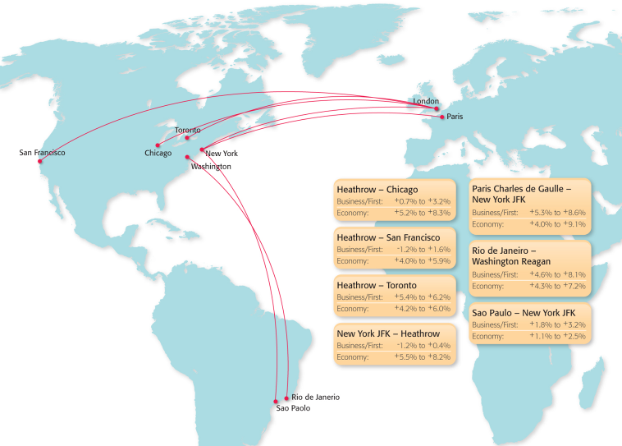
2012 Forecast
NORAM Air Detail - International

Slide 21
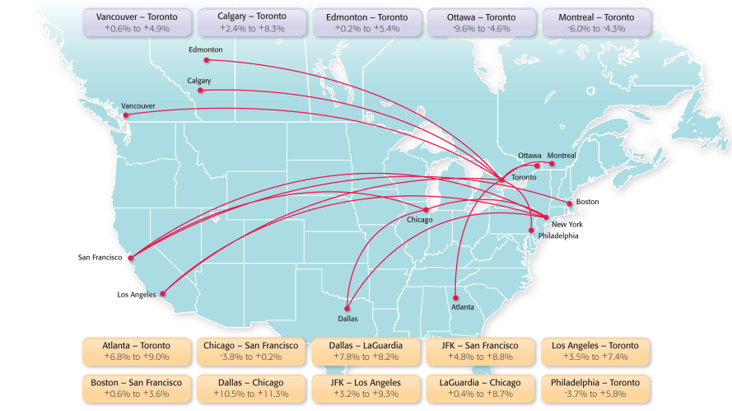
2012 Forecast
NORAM Air Detail - Domestic

Slide 22
2012 Forecast
NORAM Air
Recommendations:
Understand the value of contracts
  For both parties

Slide 23
2012 Forecast
NORAM Air
Recommendations:
Understand the value of contracts relationships
  For both parties
Segment critical spend
Adjust behavior to control costs

Slide 24
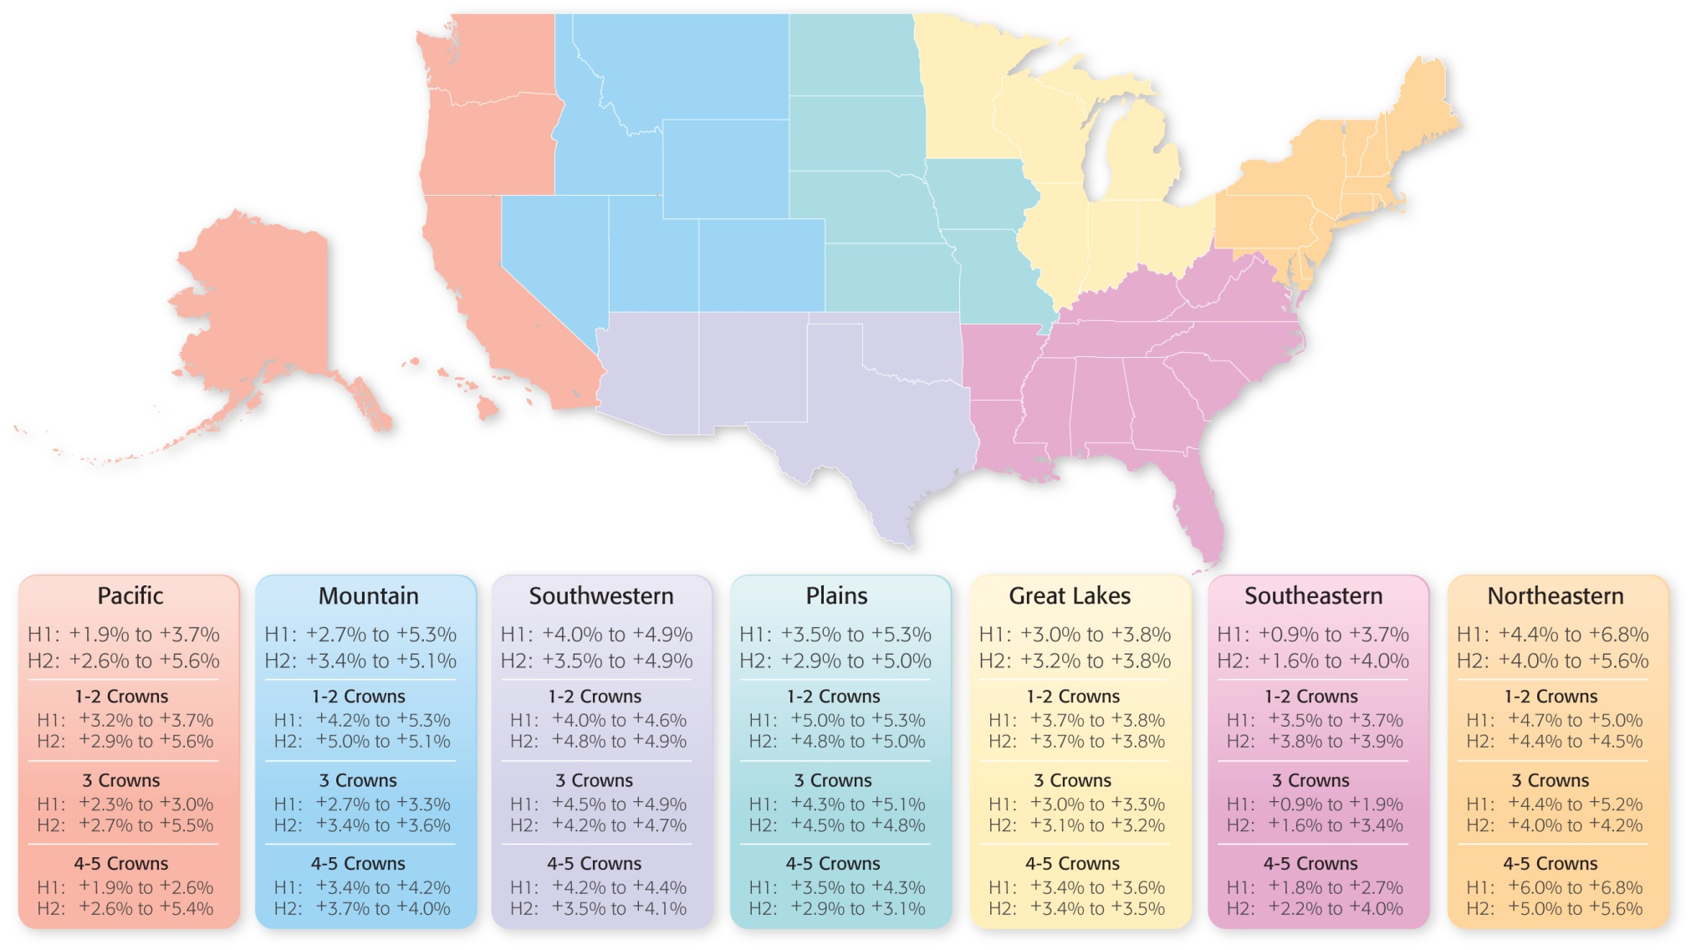

2012 Forecast
NORAM Hotel Detail – Regions

Slide 25
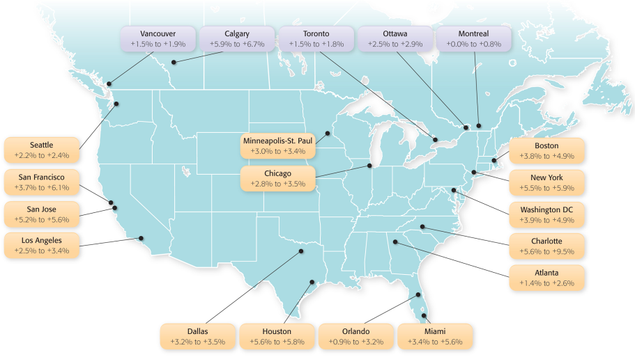
2012 Forecast
NORAM Hotel Detail - Cities

Slide 26
2012 Forecast
NORAM Hotel
Recommendations:
Value LRA in high demand markets
Acknowledge total value
  Beyond rate!
Add supplemental properties

Slide 27
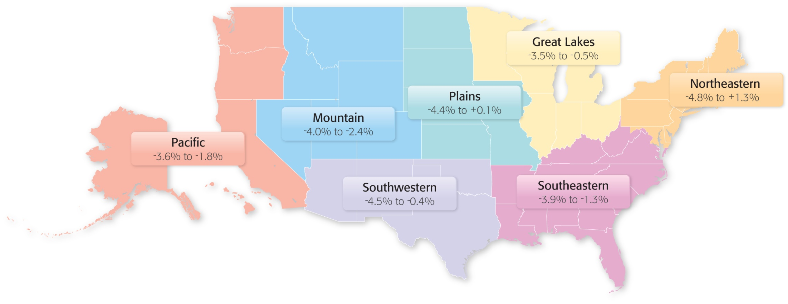
2012 Forecast
NORAM Car Detail – Regions

Slide 28
2012 Forecast
NORAM Ground
Recommendations:
Understand the value of contracts and relationships
  For both parties
Monitor the competiveness of the marketplace
Use complete data
  Inclusive of ancillary fees

Slide 29
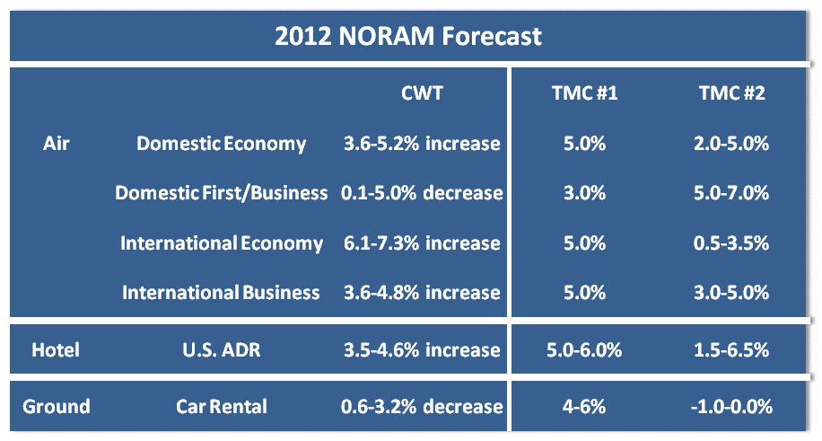
2012 Forecast
How do we compare?

Slide 30



Slide 31



