Slide 1
Tackling Email
Or a faster way to process all of those messages in your inbox!

Slide 2
Processing with the Four D’s
Delete It
Do It
Delegate It
Defer It
Notes:
The average customer deletes 50% of their email!

Slide 3
Delete It
Does it pertain to a goal or project you are currently working on?
Can the information be found somewhere else? (i.e. company library, Internet, etc.)
Will I need to refer back to it in the next 3 months?
Am I required to keep it? (HR, legal, financial)
Notes:
The average customer deletes 50% of their email!

Slide 4
Do It
Can you complete it in 2 minutes or less?
Can you scan it in 2 minutes or less to see what is needed?
If you can’t do either, then move to the next step
Notes:
Studies show that approximately 30% of emails can be actioned in 2 minutes or less

Slide 5
Delegate It
If you can delegate it over the phone or via email in 2 minutes or less, delegate it now
If you need to provide additional instruction for someone to complete the task, file the original message and add the Task to your Task List
Plan a due date agreeable to both parties to follow up after the delegated activity has been assigned and should be completed
Notes:
Deferred Items can’t be done in 2 minutes or less and can’t be delegated to others.
This is now something you will need to do.
Studies show that typically only 20% of mails require for you to actually do the work

Slide 6
Defer It
Prepare to do the actual work at a later time
Break the job into small tasks if it is a large project
Add the task(s) to your Task List and then designate a date/time or create a timeline to complete each task
Notes:
Deferred Items can’t be done in 2 minutes or less and can’t be delegated to others.
This is now something you will need to do.
Studies show that typically only 20% of mails require for you to actually do the work

Slide 7
Turn It Into What It Is
Turn an Email into an Appointment
Turn an Email into a Task with Attachment
Turn an Email into a Contact
Notes:
Studies show that approximately 30% of emails can be actioned in 2 minutes or less

Slide 8
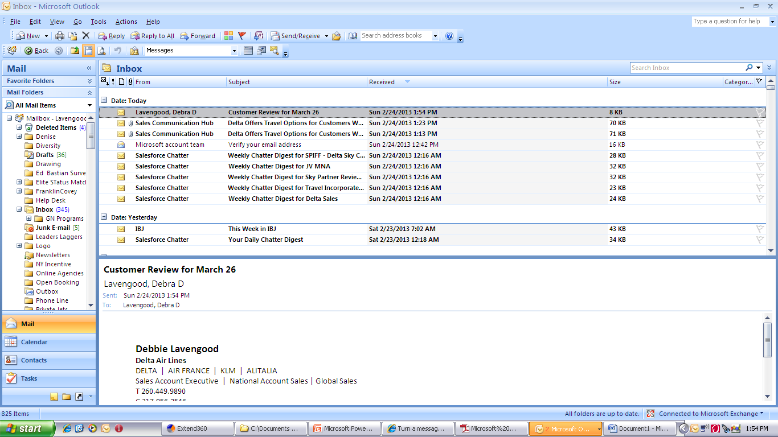
Turn An Email Into An Appointment
1) From the Inbox, click on the email
2) Then, drag the email onto your Calendar tab. The appointment will pop up for editing (see next slide)

Slide 9
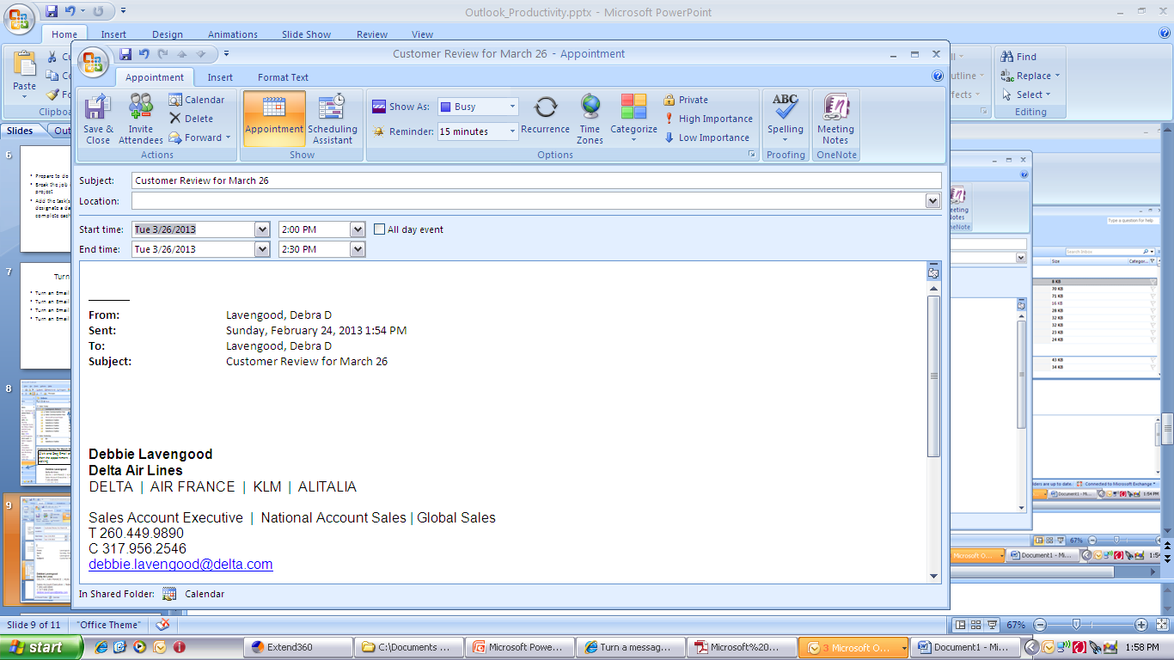
If there were attachments or instructions included in the mail, they would also be included in your calendar entry for easy access/reference .

Slide 10
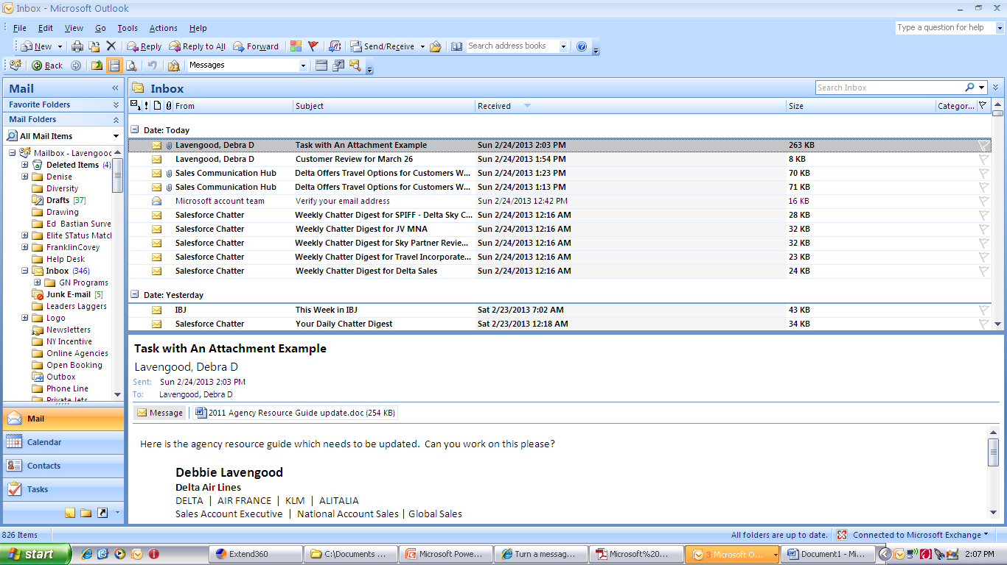
Turn An Email Into A Task with Attachment
1) From the Inbox, click on the email
2) Then, drag the email onto your TASK tab. The task will pop up for editing (see next slide)

Slide 11
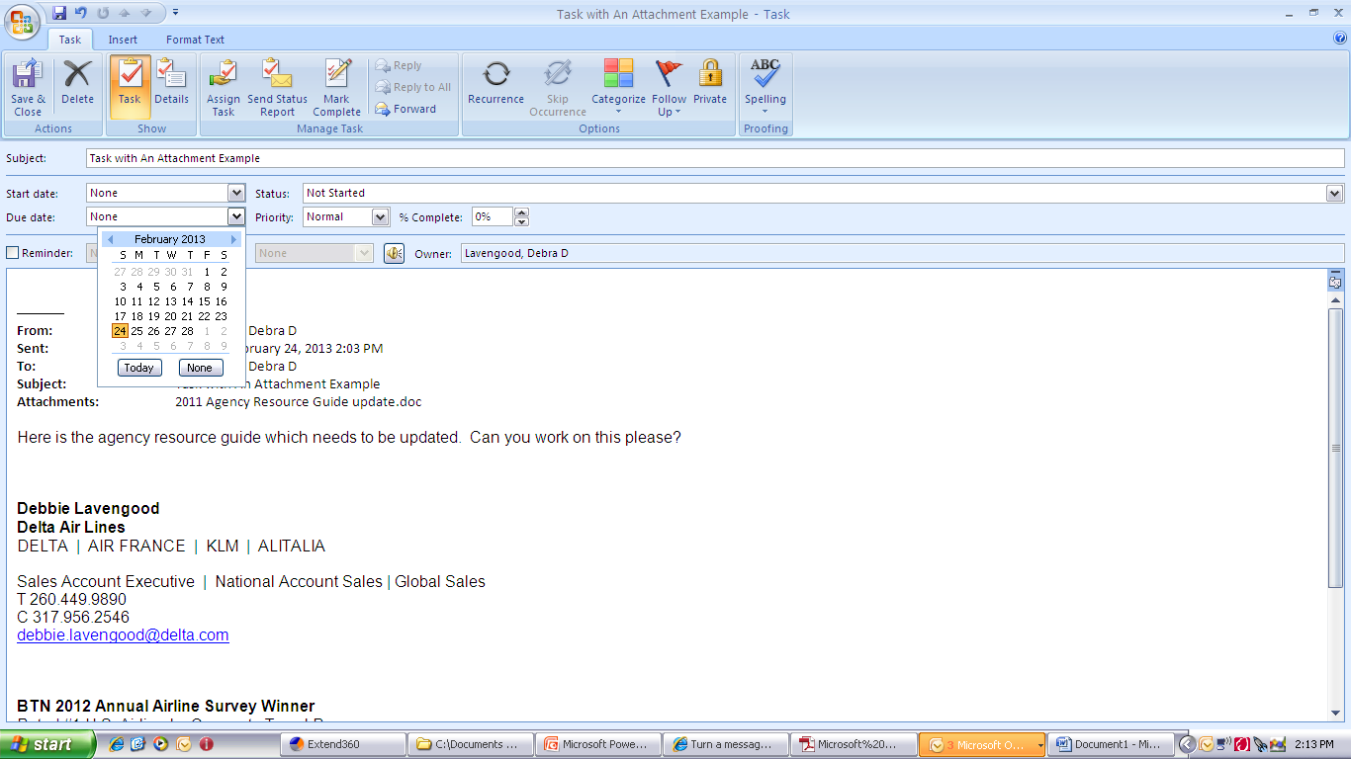
Click the Down Arrow under Due Date to select a Due Date
Click Categorize to select a category (if you are using categories) or Add a flat to use as a Reminder for Follow Up

Slide 12
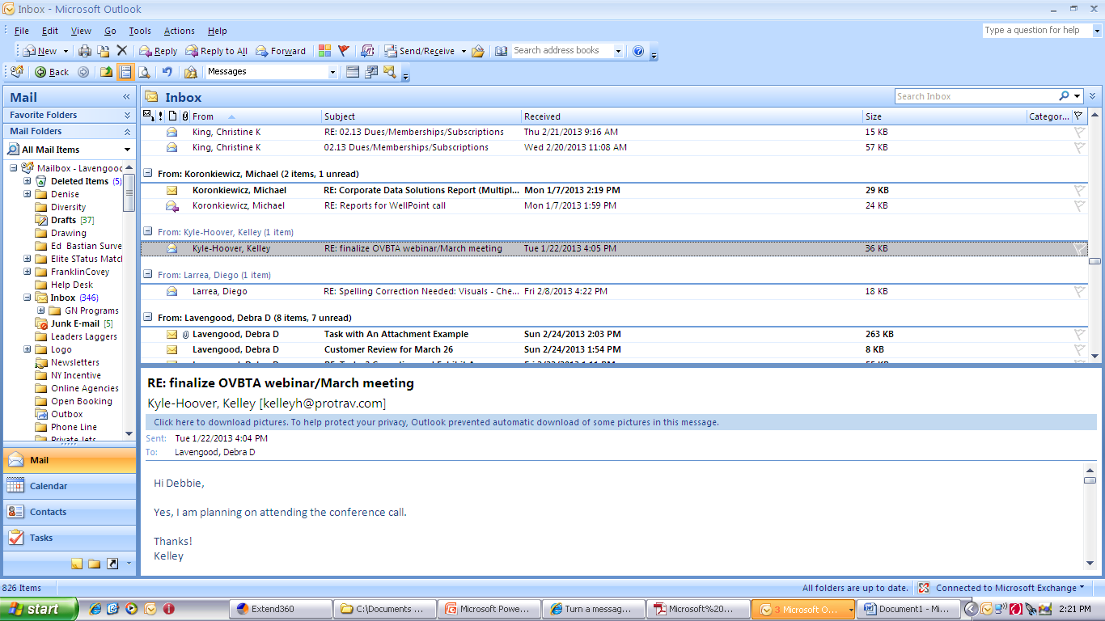

Slide 13
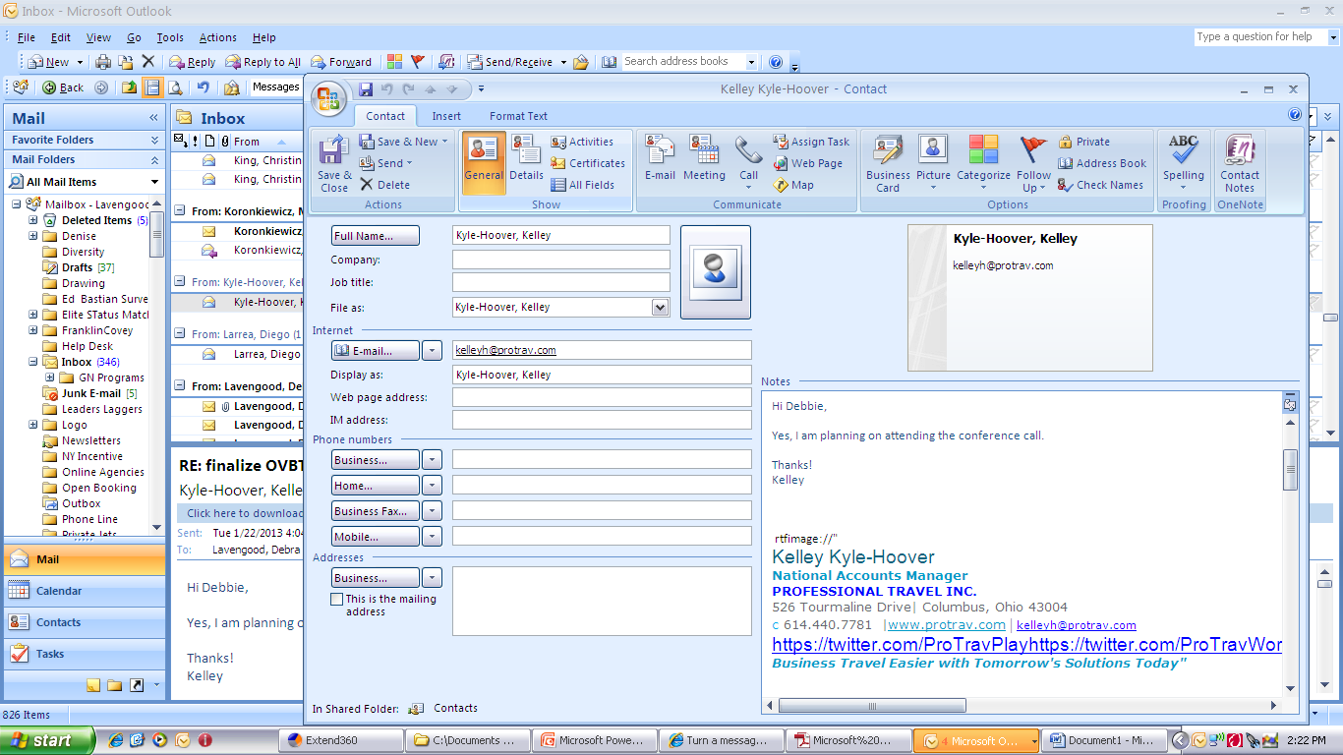
Highlight the contact areas that did not automatically populate and drag to appropriate fields in the Contact form.

Slide 14
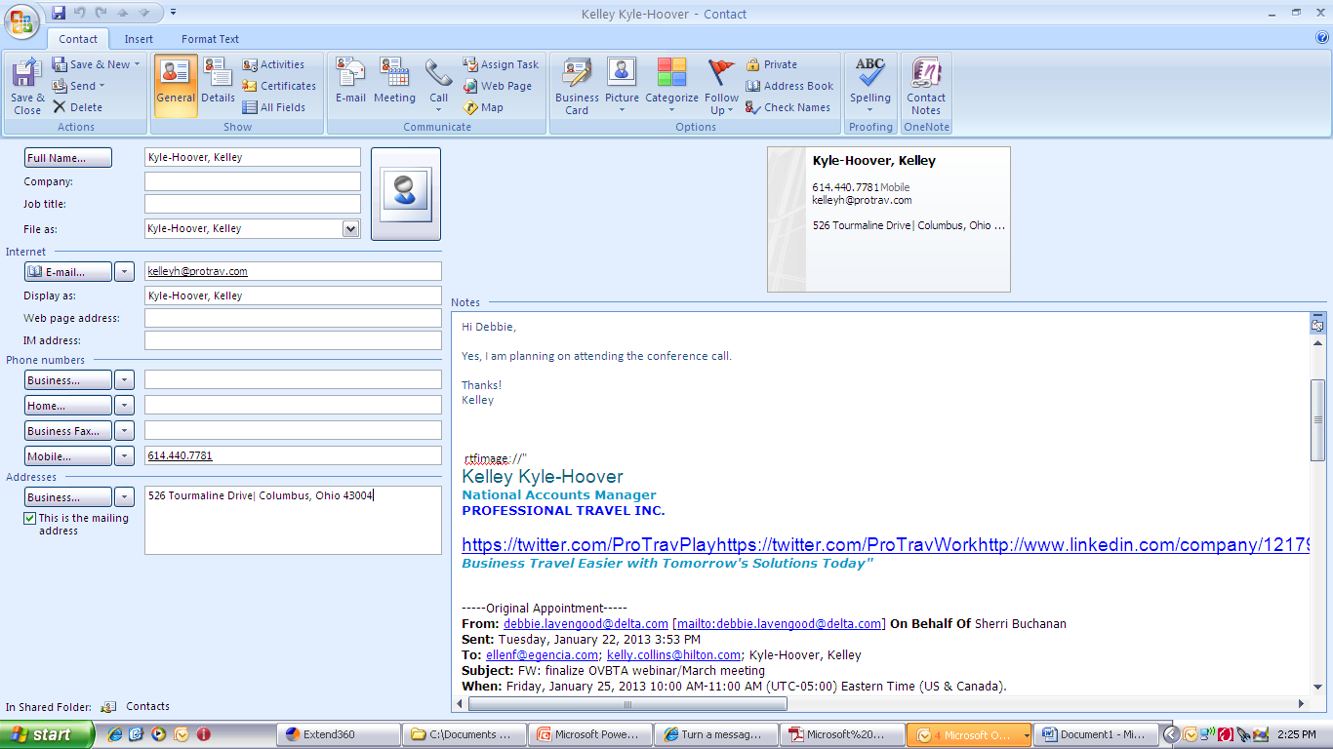

Slide 15
Creating Outlook Rules
Rule to Delete
Rule to File
Notes:
Studies show that approximately 30% of emails can be actioned in 2 minutes or less

Slide 16
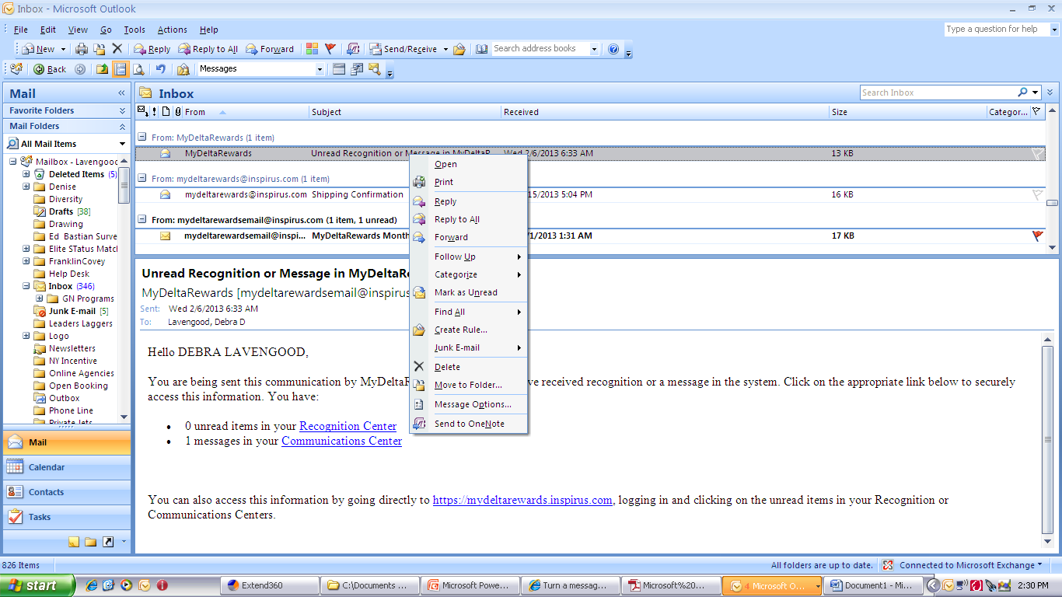
Rule to Delete
Right click on message in Inbox associated with messages you want to Delete automatically
Then click on Create Rule

Slide 17
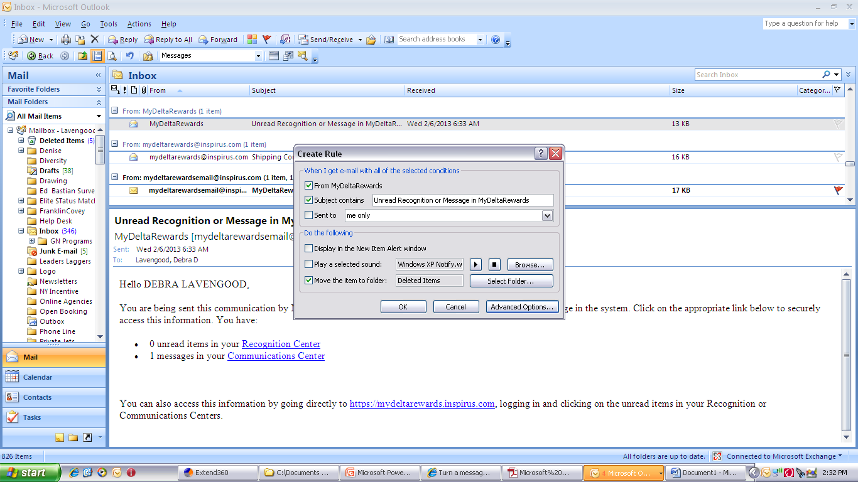

Slide 18
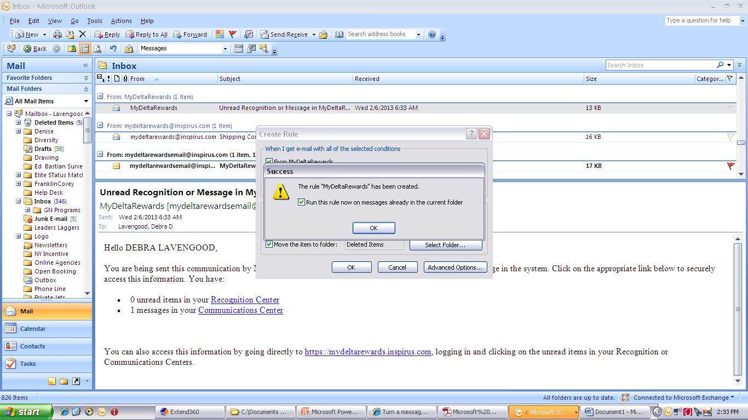

Slide 19
Rule to File
Follow same process as Rule to Delete but change the Folder to the correct one here
Then click on OK to Create Rule

Slide 20
Resources
Microsoft support online:
http://office.microsoft.com and then Support.
Scroll down to Free Training link (available topics include Excel, Outlook, Powerpoint, Word, Access, Project, etc.)
Your company
Some companies offer free online Microsoft courses as part of overall IT package- check with your Help Desk or IT dept.
Your local library
(Non-Fiction, Dewey Decimal area 005)
  Take Back Your Life (Using Microsoft Outlook to Get Organized) by Sally McGhee
  Dummies Series (Outlook for Dummies, etc.)
Notes:
Studies show that approximately 30% of emails can be actioned in 2 minutes or less

